Slide 1
CS 3002 Information Security
Dr. Abdul Aziz
Head Department of Software Engineering
NUCES – FAST (KHI)

Slide 2
CONTENTS OF THIS Week
Class 1:
Course Outline
Why IS ?
Class 2:
Class 3:

Slide 3
ACKNOWLEDGMENT
The content is provided by Dr. Nadeem Kafi, who is also the coordinator of this course.

Slide 4
OUTLINE
Information Security Foundations: Concepts
Cryptographic Tools
User Authentication
Access Control
IT Security Management
Risk Assessment
Legal and Ethical Aspects:
Introduction to:
Database Security
Malicious Software
Cloud Security
Intrusion Detection
Firewalls
Software Security

Slide 5

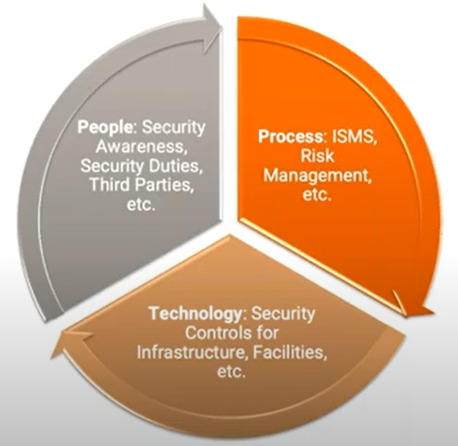

Slide 6
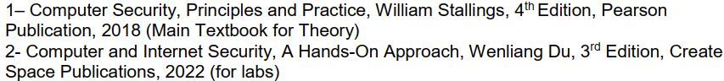
Textbook

Slide 7
A Definition of Computer Security
Measures and controls that ensure
confidentiality,
integrity, and
availability
of information system assets.
Assets including:
hardware,
software,
firmware, and
information (being processed, stored, and communicated).

Slide 8
Information Security
“the processes and methodologies which are designed and implemented to protect print, electronic, or any other form of confidential, private and sensitive information or data from unauthorized access, use, misuse, disclosure, destruction, modification, or disruption.”
Cybersecurity
“the practice of protecting systems, networks and programs from digital attacks on internet or internet-connected systems”
Network security
“the process of taking physical and software preventative measures to protect the underlying networking infrastructure from unauthorized access, misuse, malfunction, modification, destruction, or improper disclosure, thereby creating a secure platform for computers, users and programs to perform their permitted critical functions within a secure environment.”

Slide 9
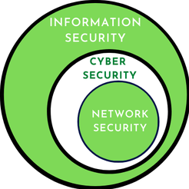

Slide 10
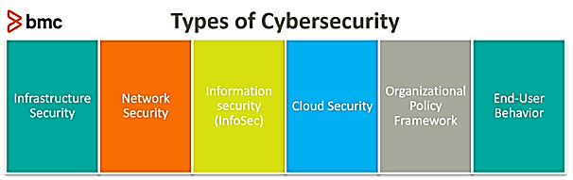
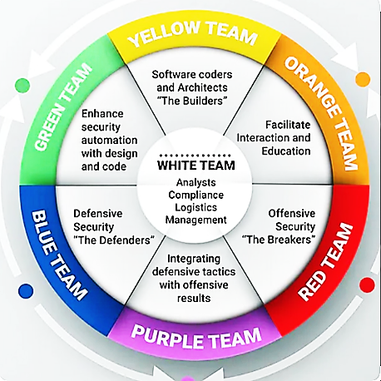
Information security
Infrastructure Hardware (CPU + Box)
Application Security
OS security
Network Security (Router, Switches, + Boxes)

Slide 11
Why to perform IS ?

Slide 12
CIA triad
C
I
A
Confidentiality
Integrity
Availability

Slide 13
Confidentiality
Preserving authorized restrictions on information access and
disclosure
This term covers two related concepts:
Data confidentiality: Assures that private or confidential information is not made available or disclosed to unauthorized individuals.
Privacy: Assures that individuals control or influence what information related to them may be collected and stored and by whom and to whom that information may be disclosed.
Integrity
This term covers two related concepts:
Data integrity: Assures that information and programs are changed only in a specified and authorized manner.
System integrity: Assures that a system performs its intended function in an unimpaired manner, free from deliberate or inadvertent unauthorized manipulation of the system.
Guarding against improper information modification or destruction
Availability
Ensuring timely and reliable access
Assures that systems work promptly and service is not denied to authorized users

Slide 14
some in the security field feel that additional concepts are needed
Authenticity: The property of being genuine and being able to be verified and trusted.
Accountability: The security goal that generates the requirement for actions
of an entity to be traced uniquely to that entity.

Slide 15
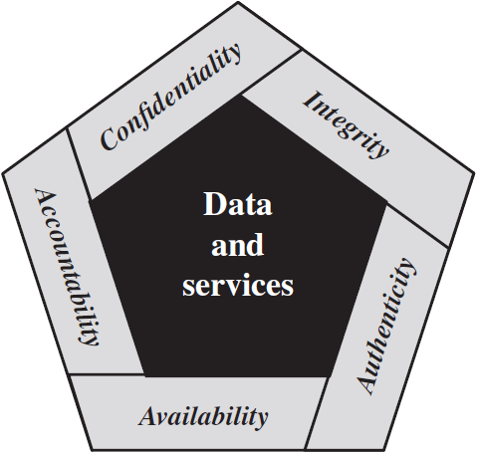
Essential Network and
Computer
Security Requirements

Slide 16
Class 2 Week 1 Treats & Attacks

Slide 17
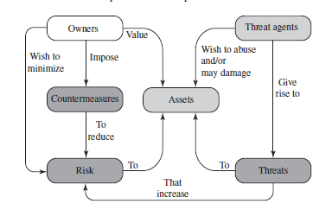
A Model for Computer Security

Slide 18
Threat
A threat represents a potential security harm to an asset.
An attack is a threat that is carried out and, if successful, leads to an undesirable violation of security, or threat consequence.
The agent carrying out the attack is referred to as an attacker or threat agent.
Vulnerabilities to a system resource are threats

Slide 19
Types of Attacks
Active attack: An attempt to alter system resources or affect their operation.
Passive attack: An attempt to learn or make use of information from the system that does not affect system resources.
Inside attack: Initiated by an entity inside the security perimeter (an “insider”).The insider is authorized to access system resources but uses them in a way not approved by those who granted the authorization.
Outside attack: Initiated from outside the perimeter, by an unauthorized or illegitimate user of the system (an “outsider”).

Slide 20
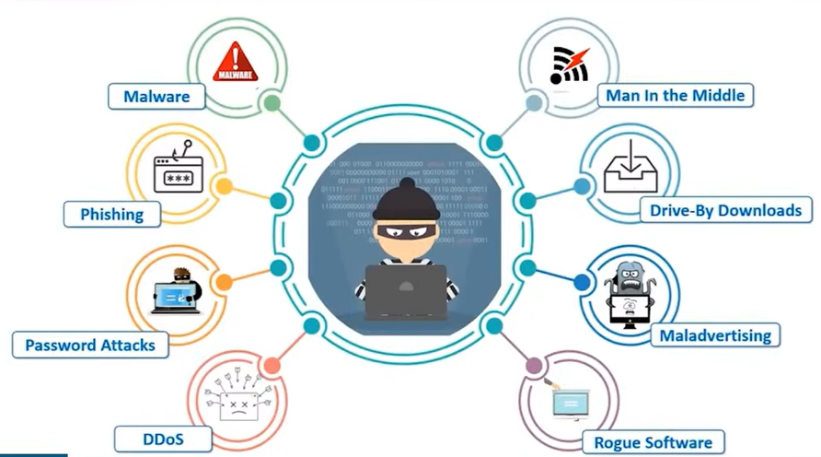

Slide 21
Interception: receive a copy of packets
Inference: traffic analysis
Intrusion: gaining unauthorized access
Deception: (Integerity)
Masquerade: posing as an authorized user
Falsification: altering or replacing of valid data or false data in a file
Repudiation: denies sending or receiving data
Misappropriation: theft of service
Misuse
Disruption: (Availability)
Incapacitation: physical destruction
Corruption: system resources or services function in an unintended manner
Obstruction: disabling communication links

Slide 22
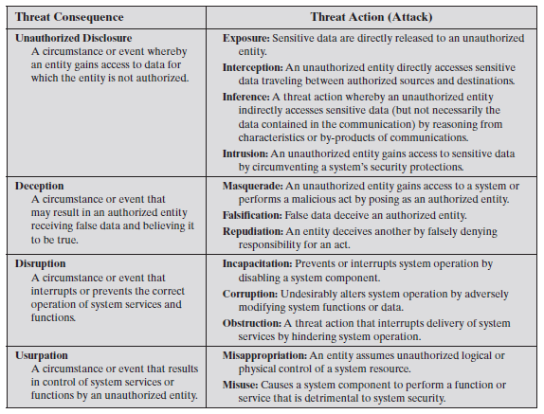

Slide 23
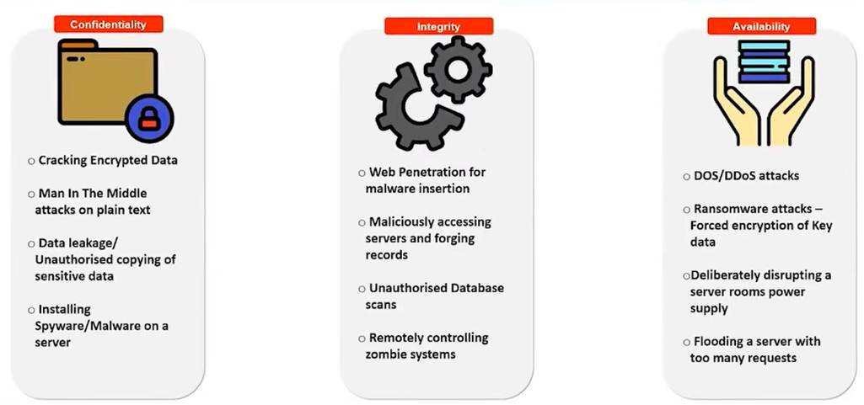

Slide 24
Class 3 , Week 1

Slide 25
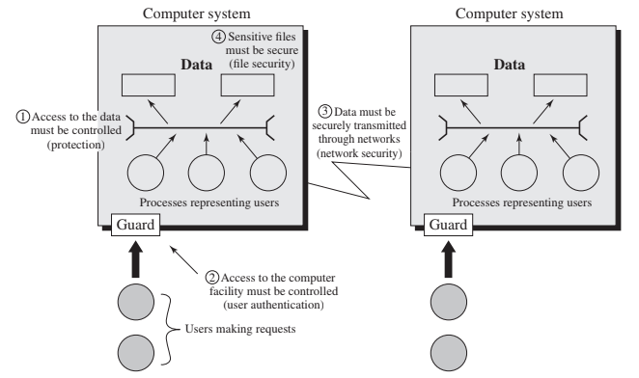
Software Scope

Slide 26
SECURITY FUNCTIONAL REQUIREMENTS
FIPS 200 (Minimum Security Requirements for Federal Information and Information Systems).
This standard enumerates 17 security related areas with regard to protecting CIA
Countermeasures are divided into two categories:
Technical
Management

Slide 27
FIPS 200
Access Control: Limit information system access
Awareness and Training: Ensure people to educate regarding security risks associated with their activities and of the applicable laws, regulations, and policies related to the security of organizational information systems. Also assign roles & responsibilities.
Audit and Accountability
Certification, Accreditation, and Security Assessments: Periodically assess the security controls in organizational
Configuration Management: Establish and maintain baseline configurations and inventories.
Contingency Planning: Establish, maintain, and implement plans for emergency response, backup operations, and post disaster recovery
Identification and Authentication
Incident Response: Adequate preparation, detection, analysis, containment, recovery, and user-response activities.
Maintenance
Media Protection
Physical and Environmental Protection
Planning
Personnel Security: Trustworthyness

Slide 28
FIPS 200
Risk Assessment
Systems and Services Acquisition
System and Communications Protection
System and Information Integrity

Slide 29
FUNDAMENTAL SECURITY DESIGN PRINCIPLES
US-National Centers of Academic Excellence [NCAE13]:
Economy of mechanism Least common mechanism
Fail-safe defaults Psychological acceptability
Complete mediation Isolation
Open design Encapsulation
Separation of privilege Modularity
Least privilege Layering
Least astonishment

Slide 30
COMPUTER SECURITY STRATEGY
Specification/policy: What is the security scheme supposed to do?
Implementation/mechanisms: How does it do it?
Correctness/assurance: Does it really work?
In Security policy, we must consider:
The value of the assets being protected
The vulnerabilities of the system
Potential threats and the likelihood of attacks
Ease of use versus security
Cost of security versus cost of failure and recovery

Slide 31
Security Implementation
Prevention
Detection
Response
Recovery
STANDARDS:
National Institute of Standards and Technology (NIST)
Internet Society (ISOC)
International Telecommunication Union (ITU)
International Organization for Standardization (ISO)

Slide 32
ATTACK SURFACES AND ATTACK TREES
Two concepts that are useful in evaluating and classifying threats:
Attack surfaces and
Attack trees.
Attack Surfaces: Reachable and exploitable vulnerabilities/weaknesses in a system.
Attack tree: Is a branching, hierarchical data structure that represents a set of
potential techniques for exploiting security vulnerabilities.

Slide 33
Attack Surfaces
Network attack surface: This category refers to vulnerabilities over an enterprise network, wide-area network, or the Internet. Included in this category are net-work protocol vulnerabilities, such as those used for a denial-of-service attack, disruption of communications links, and various forms of intruder attacks.
Software attack surface: This refers to vulnerabilities in application, utility, or operating system code. A particular focus in this category is Web server software.
Human attack surface: This category refers to vulnerabilities created by person-nel or outsiders, such as social engineering, human error, and trusted insiders.

Slide 34
Some Examples
Open ports on outward facing Web and other servers, and code listening on those ports
Services available on the inside of a firewall
Code that processes incoming data, e-mail, XML, office documents, and industry-specific custom data exchange formats
Interfaces, SQL, and web forms
An employee with access to sensitive information vulnerable to a social engineering attack

Slide 35
Attack Trees
An attack tree is a branching, hierarchical data structure that represents a set of potential techniques for exploiting security vulnerabilities
The security incident that is the goal of the attack is represented as the root node of the tree, and the ways by which an attacker could reach that goal are iteratively and incrementally represented as branches and sub-nodes of the tree.
Each subnode defines a subgoal, and each subgoal may have its own set of further subgoals, and so on.

